Slide 1

Employee Management System For Lion Security PLC

Slide 2
Introduction
Security is the prevention of possible harm caused by others.
promote order and safety
Security can be achieved by
Hiring security personnel directly or
By outsourcing companies that provide security personnel.

Slide 3
Background of the Project
The aim of this project is to create a modern employee management system to Lion Security PLC.
The system is Web-Based Application designed to automate Lion Security PLC’s management operation, Including:-
Managing the employees,
Approving security employees,
Assigning employees to their districts,
Arranging what they will wear on duty, and
Managing customer requests.

Slide 4
Statement of the problem
The current Employee Management System has the following problems.
There is a long waiting time that makes the service sluggish.
The process is tedious that involves searching through a rack.
Unsatisfied customer will may terminate the contract.
The customer needs to come in person to request security employee.
The current system don’t notify activities to be done before things get wrong.
Every operation need the use of paper. so, the cost of paper is an issue.

Slide 5
Desired State
The new system includes:
Digital registration
Automatic notification
Remotely requests
Advantage
Time Saver
Man-made error reduces
Has a Smoother process

Slide 6
Objective
General Objective:
This project aims to create an automated employee management system for Lion Security PLC.
Specific objective: To meet the general objective which
To study the working environment of Lion Security PLC.
To analyze the existing system and propose a new system.
To provide a solution for the problem which is identified above.
To design and develop an automated system.
To implement a new system
To test and evaluate the system whether it meets the objectives.

Slide 7
Scope and significance of the project
Our system includes the following main features.
Register new customer companies and employees.
Update information in the system.
Store employees and their specific company information in a database.
Notify different activities in the system.
Assigning an employee to a specific customer company.
Providing uniform cloth to employees.
Approving competent trainees to become security employees.
Allowing customers to register online.
Allowing customers to request new employees.
Generating reports based on available data.

Slide 8
Methodology
Object oriented design: highly recommended approach to implement a system
Features like encapsulation, abstraction, inheritance, and polymorphism.
Helps to keep code DRY
Easy to maintain, modify, and debug.
Data Source
Primary (Interview)
Secondary (Website, official document)
Data Collection Techniques
Interview
Document analysis
Tools used
HTML, CSS, Java script, PHP, MySQL and Xampp

Slide 9
Functional requirements
Before allowing any system feature, the system shall demand a login.
The system shall allow the sys admin to manage an employee account.
The system shall allow the HR manager to
create an employee account.
add a security employee.
manage a security employee.
manage a customer.
approve the customer registration.
approve the customer's request.
generate a report.
assign employees to a specific customer.

Slide 10
Functional requirements Con’t
The system shall allow the trainer to approve the trainee.
The system shall allow the storekeeper to provide a uniform for the employee.
The system shall allow the customer to register online.
The system shall allow the customer to request a new employee.
The system shall allow the customer to check the status of the request.

Slide 11
Non-functional requirements
Security: the system must validate the credential of the user to protect sensitive data
Performance: the system is expected to give a better performance.
Availability: the system is expected to be available 24/7 by
Preparing redundant backup
Ensuring security
Preparing disaster recovery plans
Improved network infrastructure
Maintainability: Since we followed OOP programming it is an easier approach concerning maintenance.
Portability: Since the system is a web-based system, the system is expected to support any device that can run a browser.

Slide 12
System Analysis & Design
Actor Identification: we identify the following users of our system:
System Admin
HR manager
Trainer
Store Keeper
Customer

Slide 13
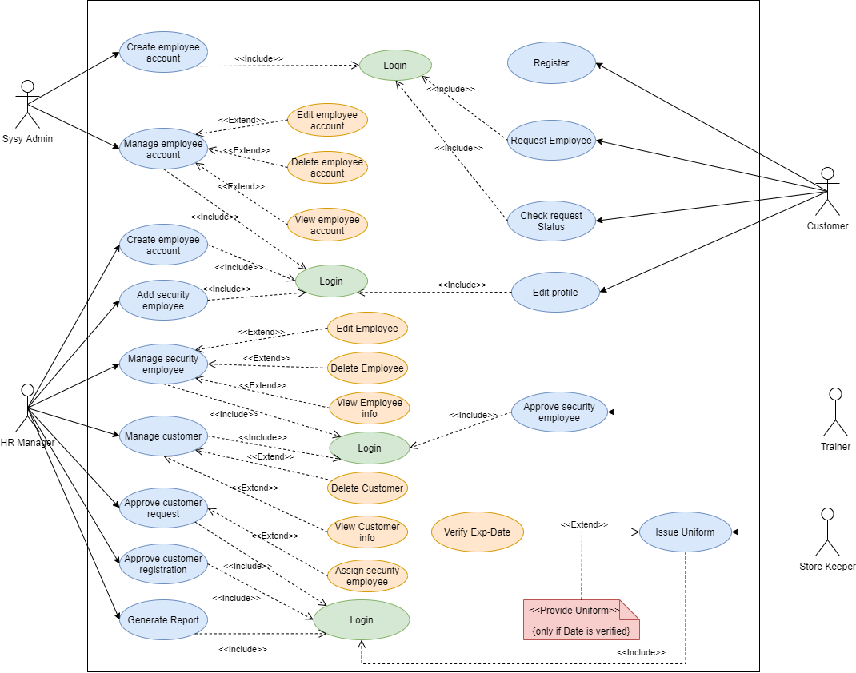
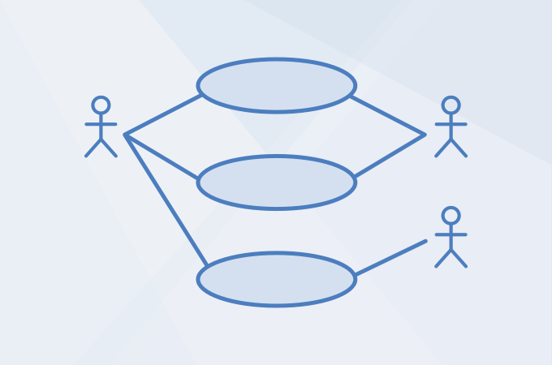
Usecase Diagram

Slide 14
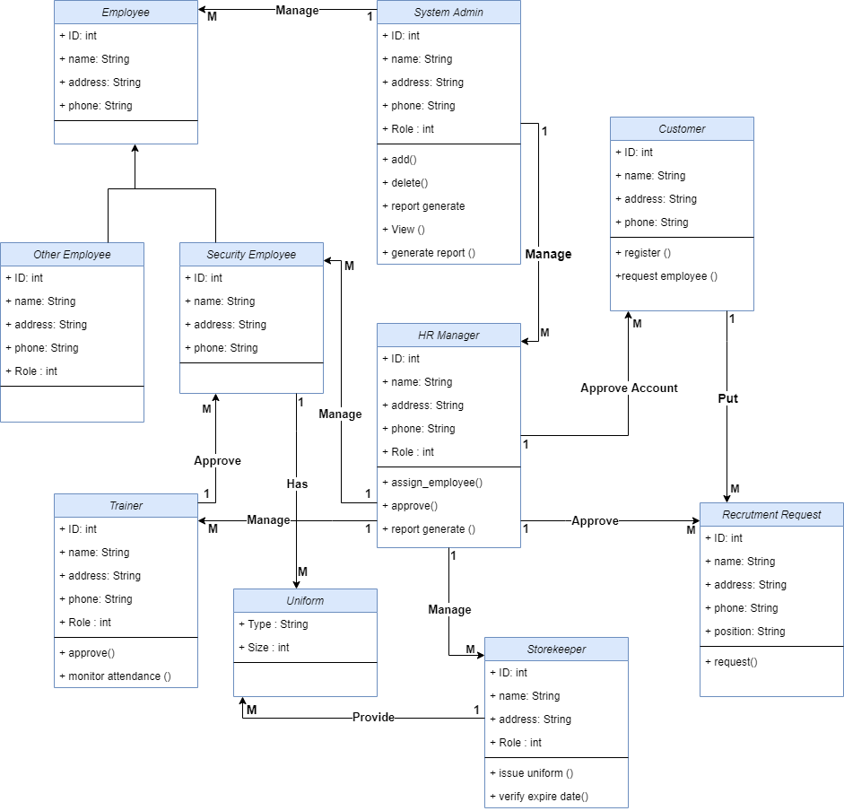
Class Diagram

Slide 15
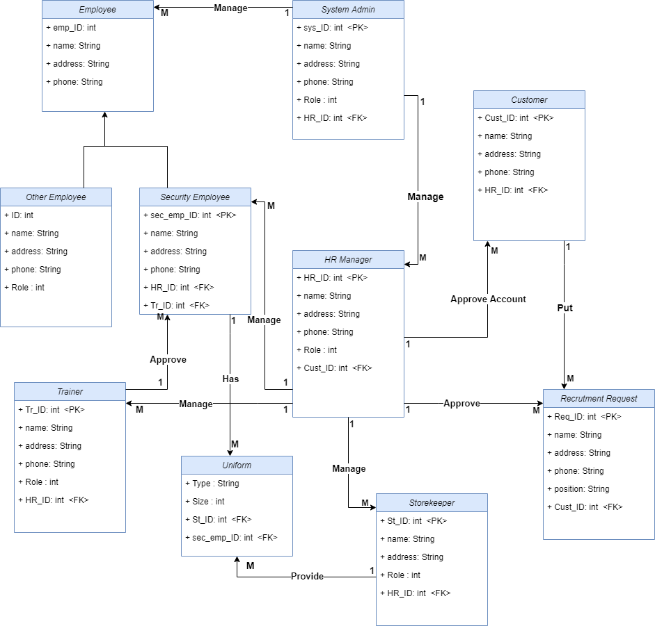
Persistent Diagram

Slide 16
DEMO

Slide 17
Conclusion
The objective of this project was to create a system that could digitalize and automate Lion Security PLC's employee management system.
Three stages make up the development process
The system is implemented successfully as intended.
4
1
2
3
Requirement collecting & analysis
Addresses the design phase
Implementation completed the third phase

Slide 18
Recommendation
The following is the list of the features we think should be included.
Payroll System
Mobile application for security employees, that help to follow up on new information.
Complain management for the customers.

Slide 19

Thank You
Thank you For your Attention

